Slide 1

VHDL (Structural Design)
Winter 1400 (Computer Aided Design)
Meisam Abdollahi
School of Computer Engineering
Iran University of Science and Technology
meisam.abdolahi@ut.ac.ir

Slide 2
Outline
Introduction to structural VHDL
Component conception
Port map
Generic map
Generate
Components in the package
Block

Slide 3
Structural VHDL (Introduction )
Structural design is the simplest to understand. This style is the closest to schematic capture and utilizes simple building blocks to compose logic functions.
Carries same information as a NET LIST
Net List = (Component instances) + (Nets)
Structural Description in VHDL =
(Signals) + (Component instances + Port maps)
Structural style allows hierarchical design of complex circuits

Slide 4
Components

Slide 5
Components
A COMPONENT is simply a piece of conventional code.
By declaring such code as being a COMPONENT, it can then be used within another circuit, thus allowing the construction of hierarchical designs.
A COMPONENT is also another way of partitioning a code and providing code sharing and code reuse
flip-flops, multiplexers, adders, basic gates,

Slide 6
Components (II)
Component is the basic unit of structural VHDL
Component declaration syntax
component <entity name>
[generic (<generic-list>);]
port (<port-list>);
end component;
Port-list and generic-list must be has the same order as in entity
Component declaration location
In the architecture body before begin
In a package

Slide 7
Components (III)
To instantiate a component a label is required, followed by the component’s name and a PORT MAP declaration
port_list is just a list relating the ports of the actual circuit to the ports of the pre-designed component

Slide 8
Component (IV)
Entiry ex is
port(a,b: in std_logic_vector(2 downto 0);
q: out std_logic_vector (2 downto 0));
End;
Architecture rtl of ex is
Begin
….
End;
------------------------------------------------------------------
Entity top_level is
port(
….
);
end;
Architecture rtl of top_level is
component ex
port(a,b: in std_logic_vector(2 downto 0);
q: out std_logic_vector (2 downto 0));
end component;
…
Begin
….
End;
Component ex
A hierarchal architecture
call component ex

Slide 9
Structural VHDL (component instantiation)
Syntax
Port map [port-association-list];
Example
architecture my_and of test is
component And2 -- Component Declaration
port ( I1, I2 : Bit; O1 : out Bit);
end component;
signal S1, S2, S3 : Bit;
begin
And2 port map ( S1, S2, S3); -- Instance
end my_and;

Slide 10
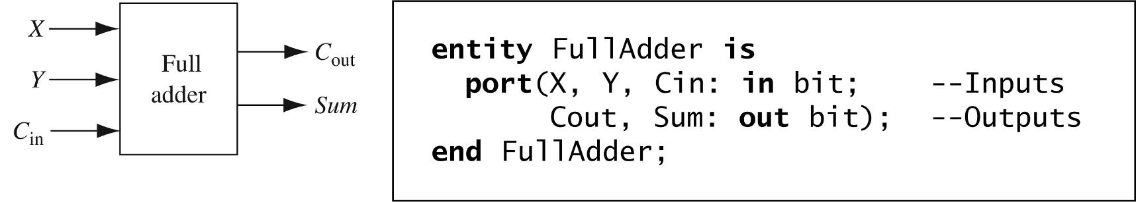
Structural VHDL (Full Example)
architecture Dataflow of FullAdder is
begin -- concurrent assignment statements
Sum <= X xor Y xor Cin after 2 ns;
Cout <= (X and Y) or (X and Cin) or (Y and Cin) after 2 ns;
end Dataflow;

Slide 11
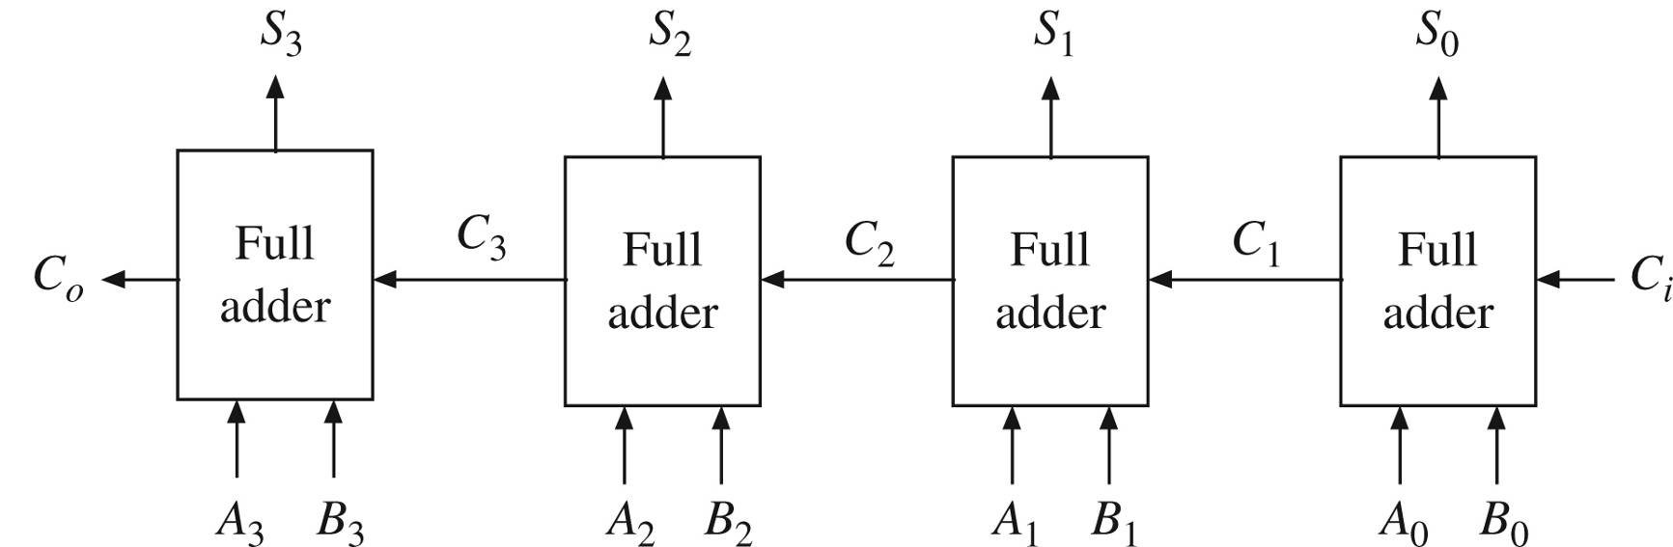
Structural VHDL (Full Example II)
4-bit Ripple-Carry Adder
entity Adder4 is
port(A, B: in bit_vector(3 downto 0);
Ci: in bit;
S: out bit_vector(3 downto 0);
Co: out bit);
end Adder4;

Slide 12
Structural VHDL (Full Example III)
architecture Structure of Adder4 is
component FullAdder
port(X, Y, Cin: in bit; -- Inputs
Cout, Sum: out bit); -- Outputs
end component;
signal C: bit_vector(3 downto 1); -- internal signal
begin --instantiate four copies of the FullAdder
FA0: FullAdder port map(A(0),B(0),Ci,C(1),S(0));
FA1: FullAdder port map(A(1),B(1),C(1),C(2),S(1));
FA2: FullAdder port map(A(2),B(2),C(2),C(3),S(2));
FA3: FullAdder port map(A(3),B(3),C(3),Co,S(3));
end Structure;

Slide 13
Port Map

Slide 14
Port Map (I)
There are two ways to map the PORTS of a COMPONENT:
Positional mapping
Nominal mapping
See Example:
The mapping is positional; that is, PORTS x and y correspond to a and b, respectively.
COMPONENT inverter IS
PORT (a: IN STD_LOGIC; b: OUT STD_LOGIC);
END COMPONENT;
...
U1: inverter PORT MAP (x, y);

Slide 15
Port Map (II)
A nominal mapping would be the following
Positional mapping is easier to write, but nominal mapping is less error-prone
U1: inverter PORT MAP (x=>a, y=>b);

Slide 16
Open outputs and inputs

Slide 17
Structural VHDL (open outputs)
architecture rtl of top_level is
component ex4
port(a, b: in std_logic; -- Inputs
q1, q2: out std_logic); -- Outputs
end component;
begin --instantiate four copies of the
C1: ex4 port map(a=>x,b=>y,q1=>t1,q2=>open);
end rtl;

Slide 18
Structural VHDL (open inputs)
architecture rtl of top_level is
component ex4
port(a, b: in std_logic; -- Inputs
q1, q2: out std_logic); -- Outputs
end component;
signal gnd: std_logic
begin --instantiate four copies of the
gnd<=‘0’;
C1: ex4 port map(a=>gnd,b=>y,q1=>t1,q2=>open);
end rtl;

Slide 19
Configuration in Structural Design

Slide 20
Configuration (I)
An entity may have more than one Architecture.
How is an specific architecture assigned to the entity?
Use the following syntax [before begin of the architecture]:
for instance_label: component_name
use entity
library_name.entity_name(architecture_name);

Slide 21
Configuration (II)
Component instances may be individually configured:
architecture STR of XA is
component HALFADD
port(A,B : in bit;
SUM, CARRY : out bit);
end component;
component ORGATE
port(A,B : in bit;
Z : out bit);
end component;
for U1 : HALFADD use entity
work.HA(BEHAVE);
for U2 : ORGATE use entity
work.OG(BEHAVE);
begin
U1: HALFADD port map (A,B,S,C);
U2: ORGATE port map (A,B,Y);
end STR;

Slide 22
Configuration (III)
The keyword all may be used to refer to all instances of a component:
for all: FULLADDER use entity
work.FULLADD(STRUCTURAL);
The keyword others may also be used to refer to all instances not explicitly mentioned.

Slide 23
Configuration (IV)
In the absence of an explicit configuration for any part of a model, default binding will occur.
Where an entity has more than one architecture, the last analysed architecture will be used.
Configuration is not usually supported by synthesis tools.
The user usually has to ensure that component and entity names and ports match, and that only one architecture per entity is analysed.

Slide 24
Configuration-Example

Slide 25
Configuration-Example (II)
Implementing two architectures for AND gate
Entity MyAND is
port (A,B : in bit;
C: out bit);
end MyAND;
architecture dataflow of MyAND is
begin
C<= A and B;
end dataflow;
architecture beh of MyAND is
begin
C<= '1' when A='1' and B = '1' else
'0';
end beh;

Slide 26
Configuration-Example (III)
Implementing two architectures for OR gate
Entity MyOR is
port (A,B : in bit;
C: out bit);
end MyOR;
architecture dataflow of MyOR is
begin
C<= A or B;
end dataflow;
architecture beh of MyOR is
begin
C<= '0' when A='0' and B = '0' else
'1';
end beh;

Slide 27
Configuration-Example (IV)
The Top Level design:
entity TopLevel is
port (A, B, C: in bit;
F: out bit);
end TopLevel;
architecture struct of TopLevel is
component MyAnd is
port (A,B: in bit;
C: out bit);
end component MyAnd;
component MyOR is
port (A,B: in bit;
C: out bit);
end component MyOR;
for C1: MyAnd use entity work.MyAND(dataflow);
for C2: MyOR use entity work.MyOR(dataflow);
for C3: MYOR use entity work.MyOR(beh);
signal t0, t1 : bit;
begin
C1: MyAND port map(A,B,t0);
C2: MyOR port map(B,C, t1);
C3: MyOR port map(t0, t1,F);
end struct;

Slide 28
Generic Map

Slide 29
Generic Map
GENERIC units can also be instantiated
A GENERIC MAP must be used in the COMPONENT instantiation to pass information to the GENERIC parameters
The new syntax is shown below

Slide 30
Structural VHDL (Generic map)
Example
entity my_comp is
generic( delay:time:=10 ns;
n : integer :=3);
port (a : in bit_vector (n-1 downto 0);
c : out bit);
end entity;
Architecture beh of and_comp is
begin
….
end architecture;
My_comp
…
n

Slide 31
Structural VHDL (Generic map II)
entity top_level is
port ( d : in bit_vector(1 downto 0);
a: in bit_vector(2 downto 0);
q1, q2 : out bit);
end entity;
Architecture beh of top_level is
component my_comp
generic ( delay: time;
n: integer);
port ( a: in bit_vector(n-1 downto 0);
c: out bit);
end component;
begin
U1: my_comp generic map ( n=>2, delay=>8 ns)
port map (d, q1);
U2: my_comp generic map (n=>3, delay=>12 ns)
port map (a, q2);
end architecture;

Slide 32
Structural VHDL (Generic map III)
Synthesis result
d1 q1
d2
d3
d4 q2
d5
U1
U2

Slide 33
Generate

Slide 34
Generate (I)
GENERATE is another concurrent statement
It is equivalent to the sequential statement LOOP in the sense that it allows a section of code to be repeated a number of times, thus creating several instances of the same assignments.
The syntax
label: FOR identifier IN range GENERATE
(concurrent assignments)
END GENERATE;

Slide 35
Generate (II)
An irregular form is also available, which uses IF/GENERATE
Here ELSE is not allowed.
IF/GENERATE can be nested inside FOR/GENERATE
label1: FOR identifier IN range GENERATE
...
label2: IF condition GENERATE
(concurrent assignments)
END GENERATE;
...
END GENERATE;

Slide 36
Generate (III)
Example
SIGNAL x: BIT_VECTOR (7 DOWNTO 0);
SIGNAL y: BIT_VECTOR (15 DOWNTO 0);
SIGNAL z: BIT_VECTOR (7 DOWNTO 0);
...
G1: FOR i IN x'RANGE GENERATE
z(i) <= x(i) AND y(i+8);
END GENERATE;

Slide 37
Generate (IV)
Important Remark: both limits of the range must be static
Example: consider the code below, where choice is an input (non-static) parameter. This kind of code is generally not synthesizable
NotOK: FOR i IN 0 TO choice GENERATE
(concurrent statements)
END GENERATE;

Slide 38
Generate (V)
We also must to be aware of multiply-driven (unresolved) signals
Example
Fine
OK: FOR i IN 0 TO 7 GENERATE
output(i)<='1' WHEN (a(i) AND b(i))='1' ELSE '0';
END GENERATE;
Not OK
NotOK: FOR i IN 0 TO 7 GENERATE
accum <="11111111" WHEN (a(i) AND b(i))='1' ELSE "00000000";
END GENERATE;
Not OK
NotOK: For i IN 0 to 7 GENERATE
accum <= accum + 1 WHEN x(i)='1';
END GENERATE;

Slide 39
Structural VHDL (Generate)
To generate several sample of a component
Example
entity top is
port ( a, b: in std_logic_vector(4 downto 0);
q: out std_logic_vector(4 downto 0));
end entity;
Architecture rtl of top is
component C1
generic( delay: time;
n: integer);
port( a, b : in std_logic;
q : out std_logic);
end component;
Begin
c_gen: for I in 0 to 4 generate
U: C1 port map ( a(i), b(i), q(i));
end generate c_gen;
end architecture;
Label is necessary
Label is necessary

Slide 40
Structural VHDL (Components in packages I )
If the components are defined in packages, no component declaration is needed in the architecture when the component is instantiated
Example
package my_pack is
function minimum (a,b:in std_logic) return std_logic;
component c1 port(clk,resetn,din:in std_logic; q1,q2:out std_logic);
end component;
component c2 port(a,b:in std_logic; q:out std_logic); end component;
end mypack;
package body mypack is
….. -- package body
end mypack;

Slide 41
Structural VHDL (Components in packages II )
To use the component the declaration of the package is needed in the beginning of the VHDL code, only:
library ieee;
use ieee.std_logic_1164.ALL;
use work.my_pack.ALL;
entity ex is
port(clk,resetn:in std_logic; d1,d2:out std_logic; a,b: in std_logic_vector(3 downto 0);
q1,q2,q3: out std_logic; q4:out std_logic_vector(3 downto 0));
end entity;
Architecture rtl of ex is
begin
U1: c1 port map(clk,resetn,d1,q1,q2);
U2: c2 port map(d1,d2,q3);
end architecture;
Nothing, here

Slide 42
BLOCK

Slide 43
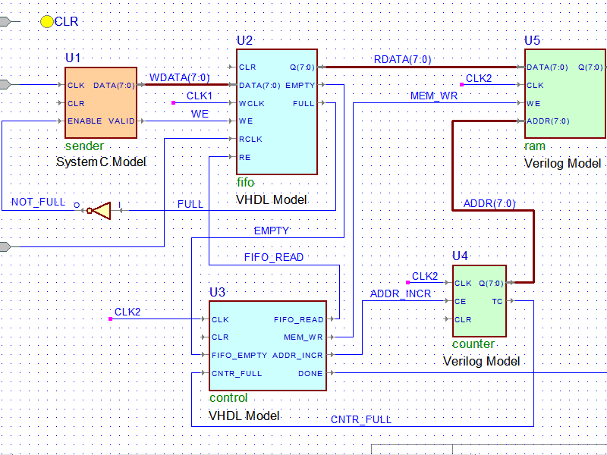
Block
There are two kinds of BLOCK statements:
Simple
Guarded

Slide 44
Simple BLOCK (I)
The simple BLOCK statement represents only a way of locally partitioning the code.
It allows a set of concurrent statements to be clustered into a BLOCK,
Objectives: turning the overall code more readable and more manageable
Syntax
label: BLOCK
[declarative part]
BEGIN
(concurrent statements)
END BLOCK label;

Slide 45
overall aspect of a “blocked’’
------------------------
ARCHITECTURE example ...
BEGIN
...
block1: BLOCK
BEGIN
...
END BLOCK block1
...
block2: BLOCK
BEGIN
...
END BLOCK block2;
...
END example;
------------------------

Slide 46
Simple Block (II)
b1: BLOCK
SIGNAL a: STD_LOGIC;
BEGIN
a <= input_sig WHEN ena='1' ELSE 'Z';
END BLOCK b1;
Block Example:
A BLOCK can be nested inside another BLOCK
label1: BLOCK
[declarative part of top block]
BEGIN
[concurrent statements of top block]
label2: BLOCK
[declarative part nested block]
BEGIN
(concurrent statements of nested block)
END BLOCK label2;
[more concurrent statements of top block]
END BLOCK label1;

Slide 47
Guarded BLOCK (I)
A guarded BLOCK is a special kind of BLOCK, which includes an additional expression, called guard expression.
A guarded statement in a guarded BLOCK is executed only when the guard expression is TRUE
Statements can be without guarded expression, but they ignore the condition statement
Using guarded block, even sequential circuits can also be constructed
However, is not a usual design approach
label: BLOCK (guard expression)
[declarative part]
BEGIN
(concurrent guarded and unguarded statements)
END BLOCK label;

Slide 48
Guarded BLOCK (II)
Example: Latch Implemented with a Guarded BLOCK
1 -------------------------------
2 LIBRARY ieee;
3 USE ieee.std_logic_1164.all;
4 -------------------------------
5 ENTITY latch IS
6 PORT (d, clk: IN STD_LOGIC;
7 q: OUT STD_LOGIC);
8 END latch;
9 -------------------------------
10 ARCHITECTURE latch OF latch IS
11 BEGIN
12 b1: BLOCK (clk='1')
13 BEGIN
14 q <= GUARDED d;
15 END BLOCK b1;
16 END latch;
17 -------------------------------
q<=GUARDED d (line 14) is a guarded statement. Therefore, q<=d will only occur if clk='1'.
What does happen if we remove
the “GUARDED” word?
Answer: The guarded expression (clk=‘1’)
will be neutral.

Slide 49
Guarded BLOCK (III)
Example: DFF Implemented with a Guarded BLOCK
-------------------------------
2 LIBRARY ieee;
3 USE ieee.std_logic_1164.all;
4 -------------------------------
5 ENTITY dff IS
6 PORT ( d, clk, rst: IN STD_LOGIC;
7 q: OUT STD_LOGIC);
8 END dff;
9 -------------------------------
10 ARCHITECTURE dff OF dff IS
11 BEGIN
12 b1: BLOCK (clk'EVENT AND clk='1')
13 BEGIN
14 q <= GUARDED '0' WHEN rst='1' ELSE d;
15 END BLOCK b1;
16 END dff;
17 ------------------------------
A positive-edge sensitive D-type flip-flop
with synchronous reset
clk'EVENT AND clk='1' (line 12) is the guard expression, while q <= GUARDED '0‘ WHEN rst='1' (line 14) is a guarded statement
q<='0' will occur when the guard expression is true and rst is ‘1’

